Slide 1
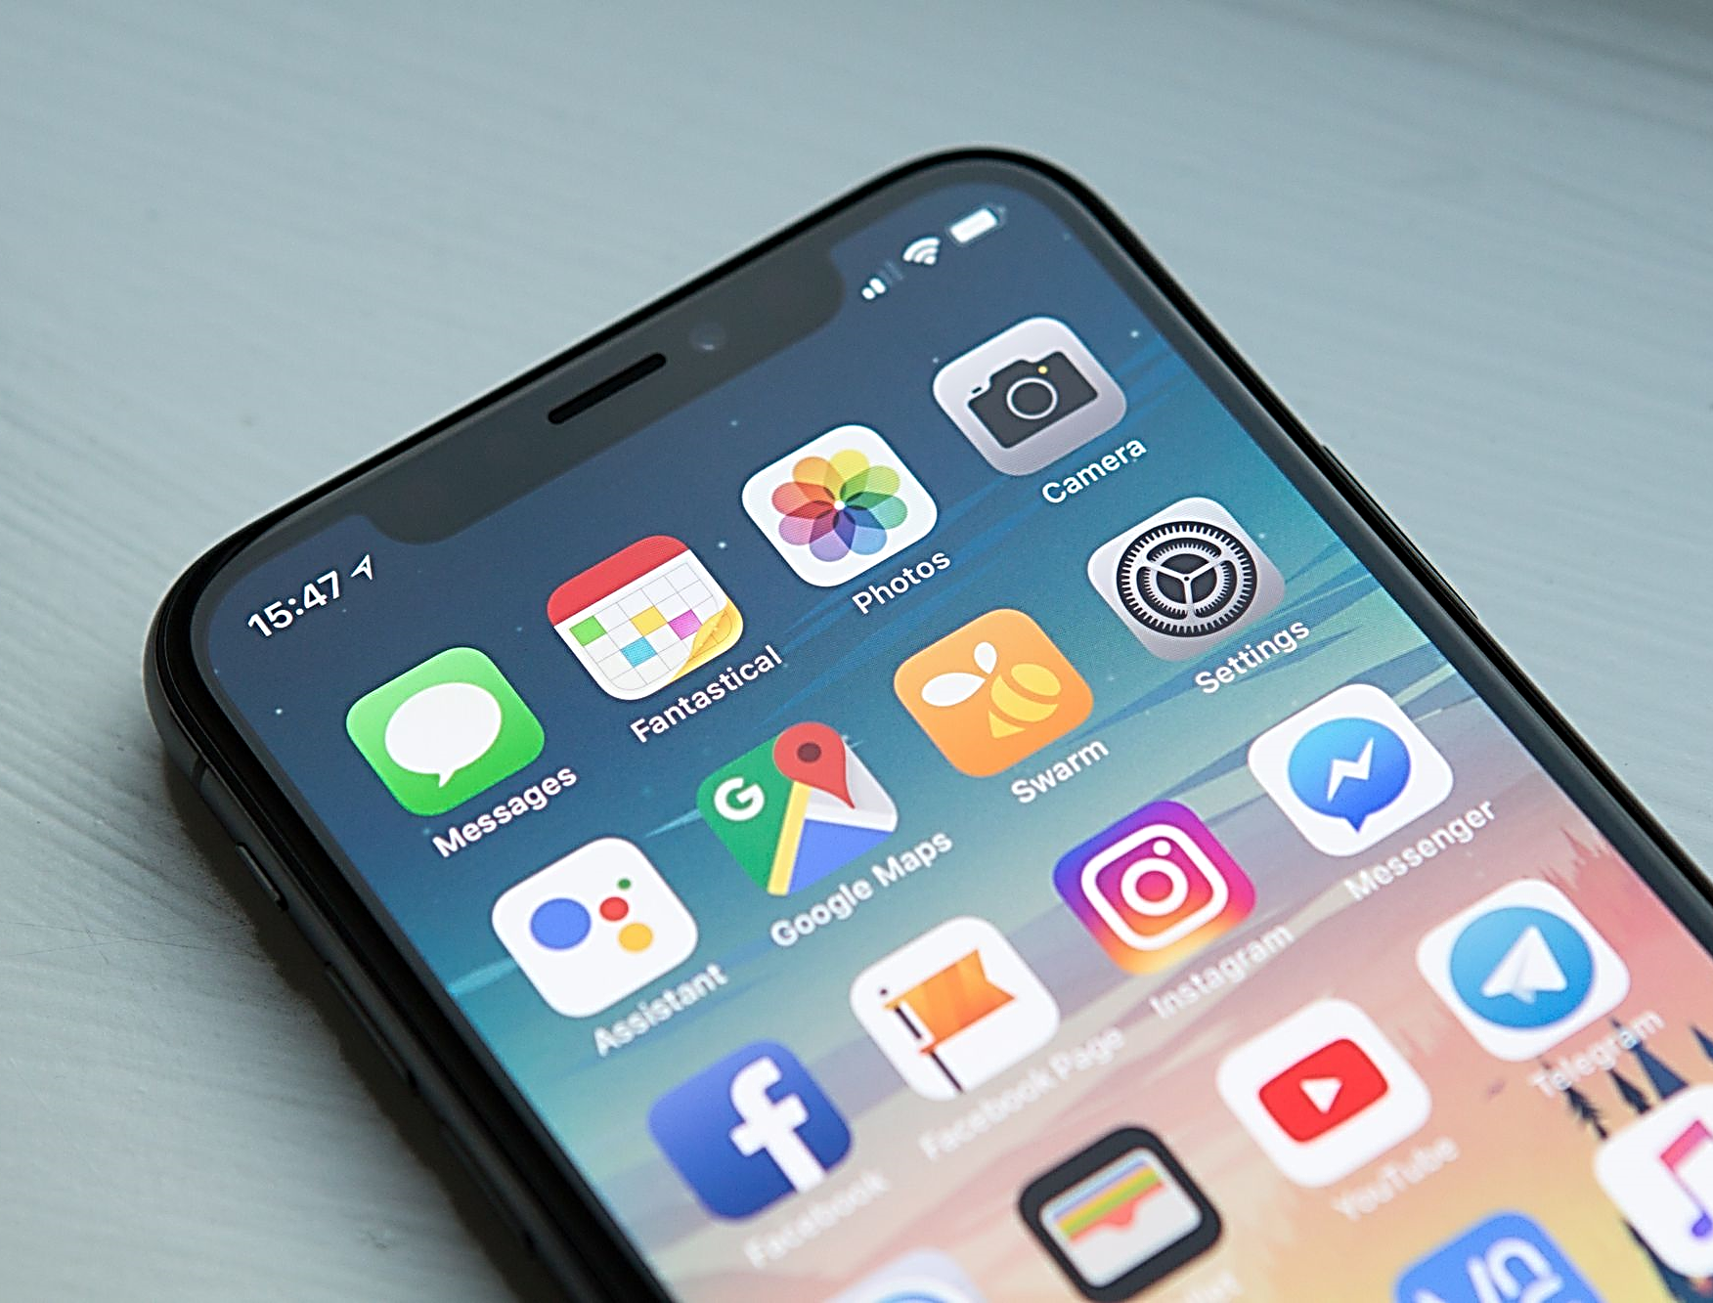
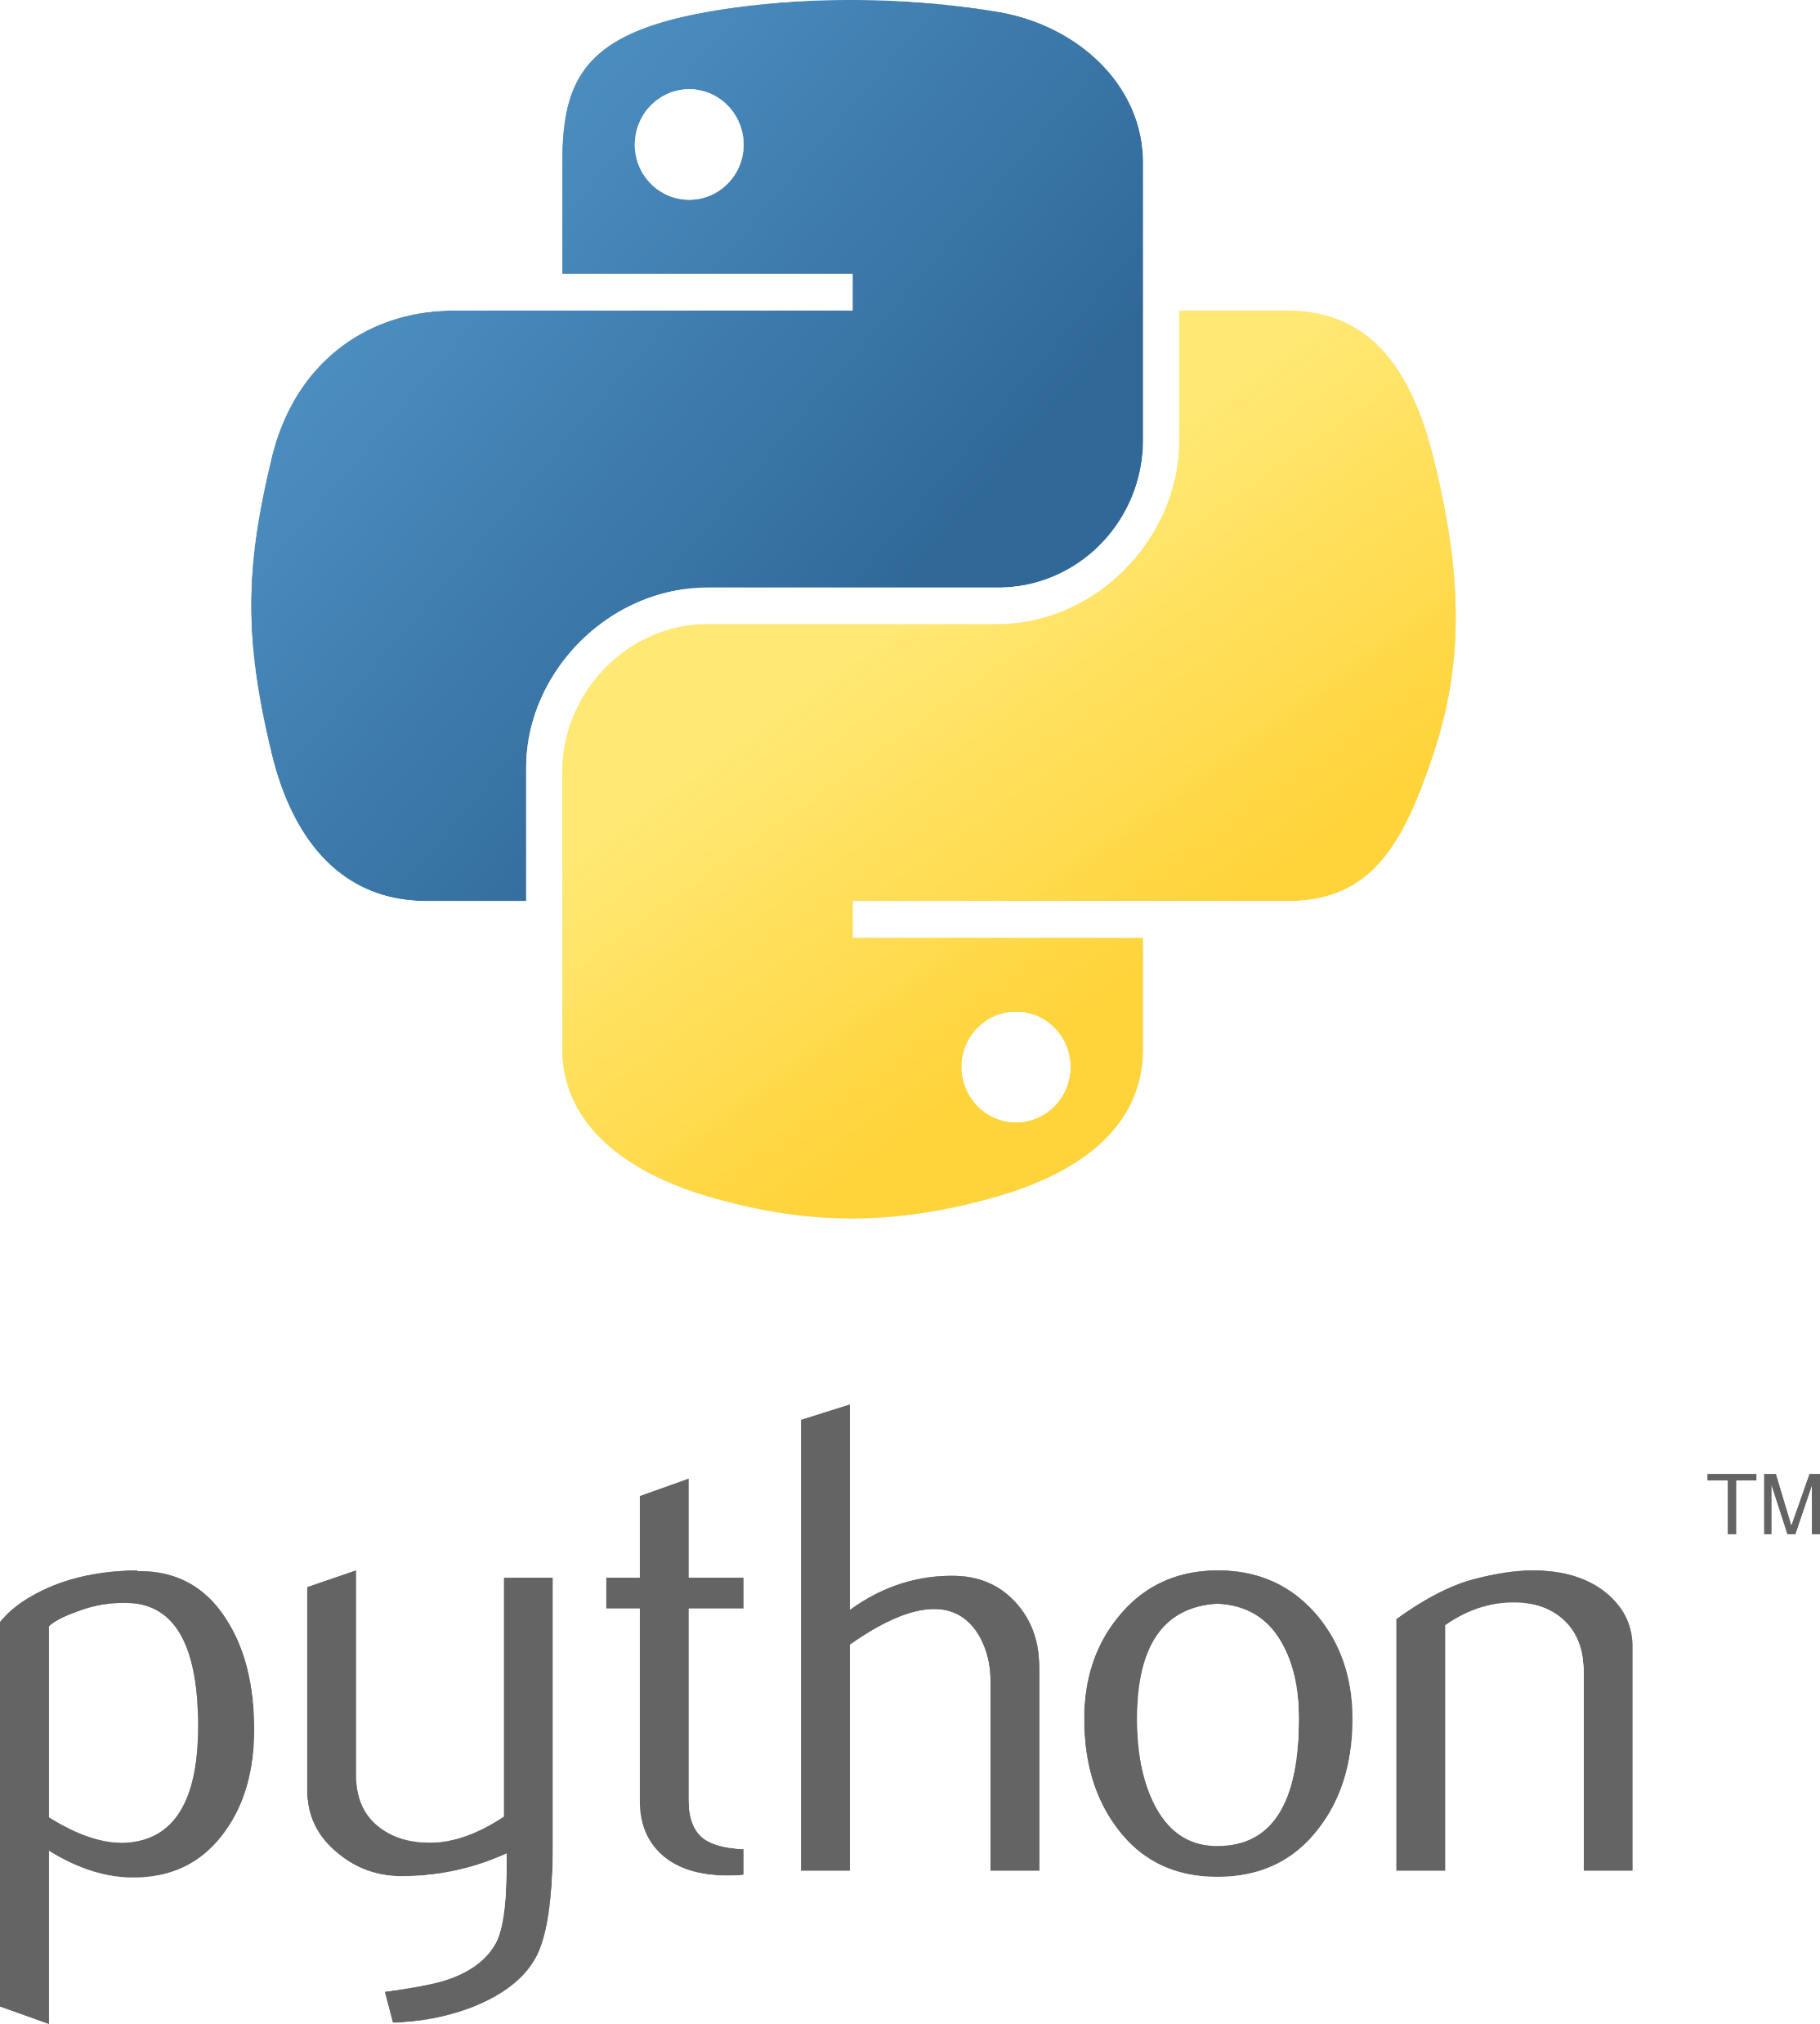

Mobile Apps Programming
P E D Putra, M.Si.
Lecture 3 – Building a mobile apps using Kivy & kivyMD

Slide 2

Getting started with Kivy
1
sub-classing the App class
2
implementing its build() method so it returns a Widget instance
3
instantiating this class, and calling its run() method
Creating a kivy application is as simple as:
This is the minimum step we need to implement to create a mobile apps using kivy

Slide 3
Getting started with Kivy
Let's start with line code
from kivy.app import App
The base Class of our mobile App inherits from the App class
from kivy.uix.label import Label
The ‘uix’ is the module within the kivy library.
The ‘label’ is the class or component imported from ‘uix’ module
class MyApp(App):
This is how we defining the Base Class of our Kivy App.
The ‘MyApp’ is the name, can be change with anything.
def build(self):
This is the function where you should initialize and return your Root Widget
return Label(text='Hello world')
This Label will be the Root Widget of this App
if __name__ == '__main__’:
MyApp().run()
Here the class MyApp is initialized and its run() method called.

Slide 4
Getting started with Kivy
Compile everything
import kivy
from kivy.app import App
from kivy.uix.label import Label
class MyApp(App):
def build(self):
return Label(text='Hello Alfa Prima’)
if __name__ == '__main__’:
MyApp().run()
Save as
main.py
How to run
In anaconda prompt (windows):
python main.py
In Spyder (windows/macOs/Linux):
Click ‘run’ or shift + enter

Slide 5
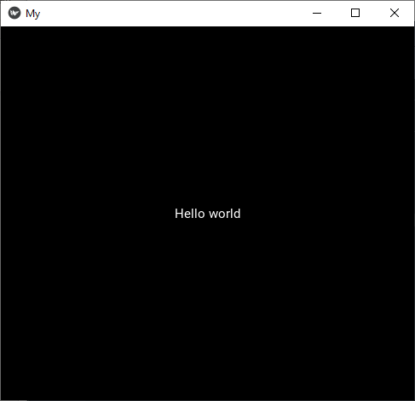
Getting started with Kivy

Slide 6
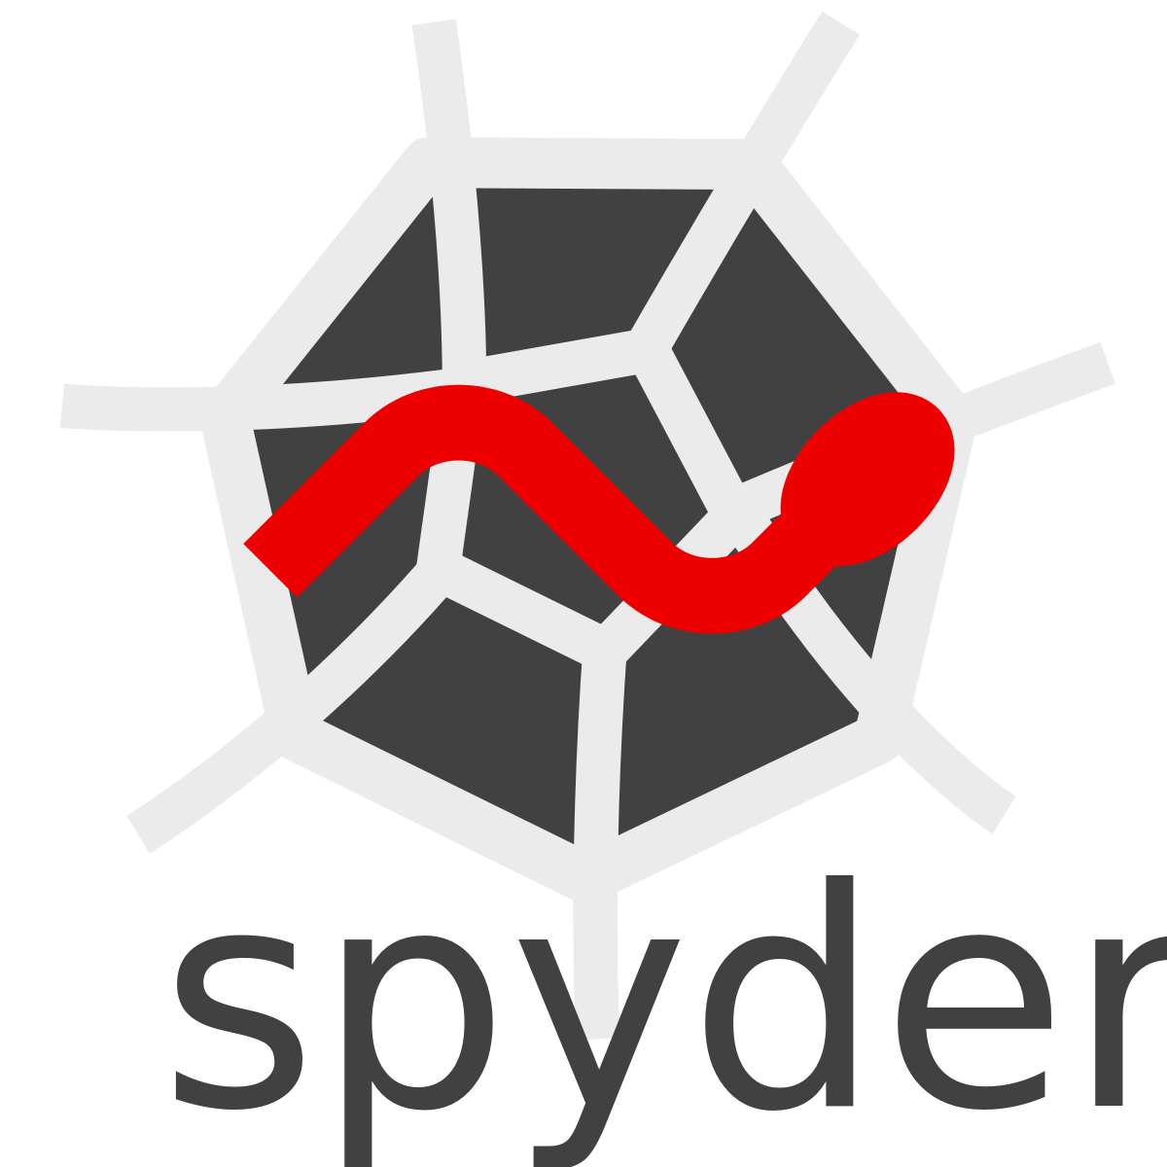
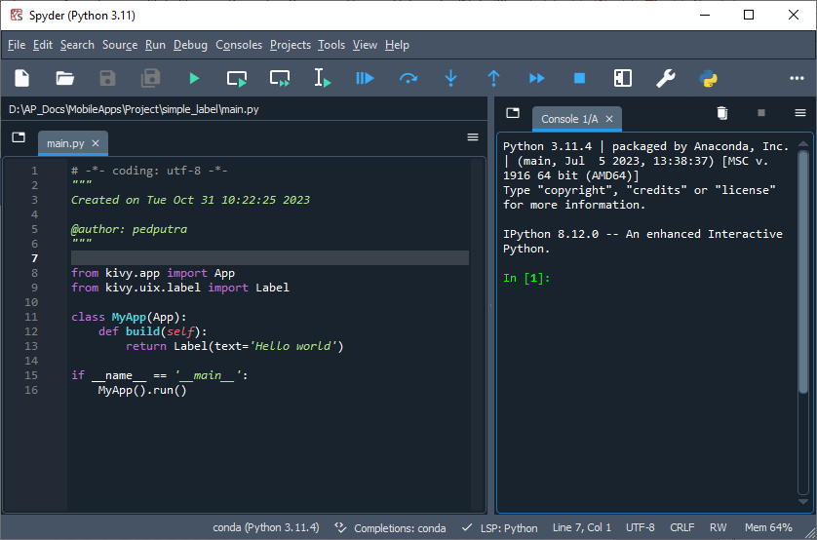
Introduction to Spyder IDE
via anaconda prompt (windows), type ‘spyder’ and hit enter
The main editor
Run
Console, terminal editor

Slide 7
Introduction to Spyder IDE
via anaconda prompt (windows), type ‘spyder’ and hit enter
Use this to run or install any necessary library
Coding start here
Run

Slide 8
Introduction to Spyder IDE
via anaconda prompt (windows), type ‘spyder’ and hit enter
Use this to run or install any necessary library
Adjust the necessary panel here
Coding start here

Slide 9
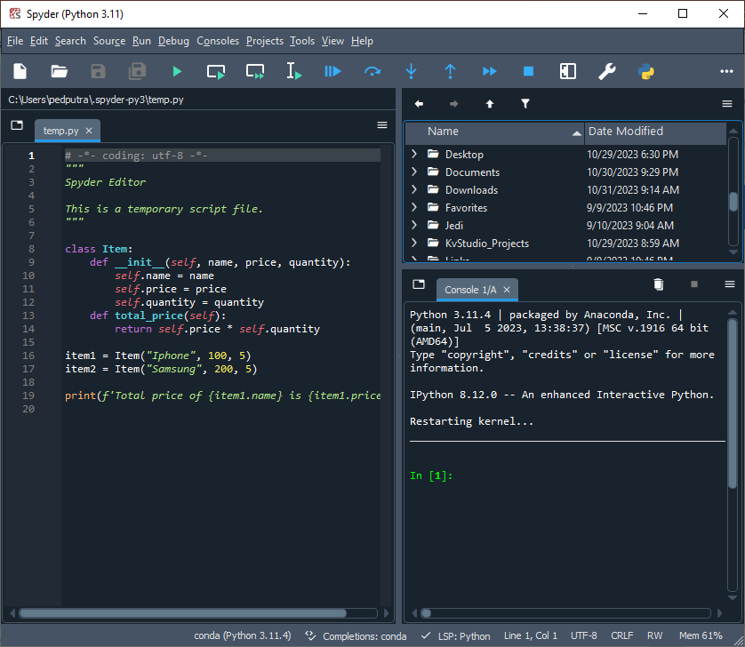
Introduction to Spyder IDE
To work with file tree (explorer), do click
View >> Panes >> Files

Slide 10
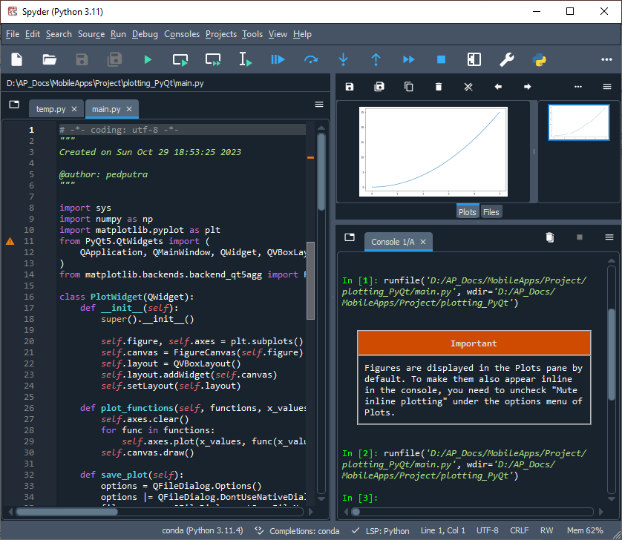
Introduction to Spyder IDE
To see the plot, do click
View >> Panes >> Plots

Slide 11
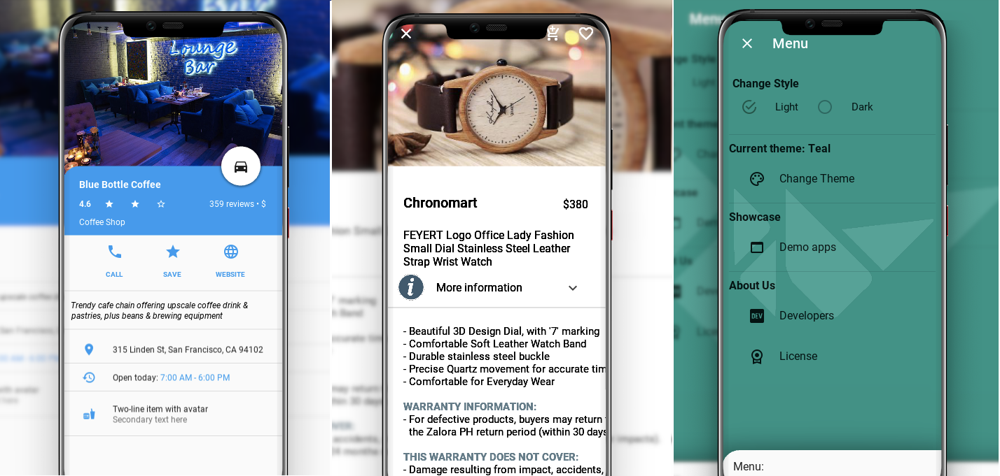
Getting started with KivyMD
Is a collection of Material Design compliant widgets for use with, Kivy cross-platform graphical framework a framework for cross-platform, touch-enabled graphical applications.

Slide 12

Getting started with KivyMD
Installing kivyMD
pip install kivymd
If we want to install development version from master branch
pip install https://github.com/kivymd/KivyMD/archive/master.zip
We also can install manually from sources
git clone https://github.com/kivymd/KivyMD.git --depth 1
cd KivyMD
pip install .
See documentation at https://kivymd.readthedocs.io
Wiki with examples of using KivyMD widgets: https://github.com/kivymd/KivyMD/wiki

Slide 13
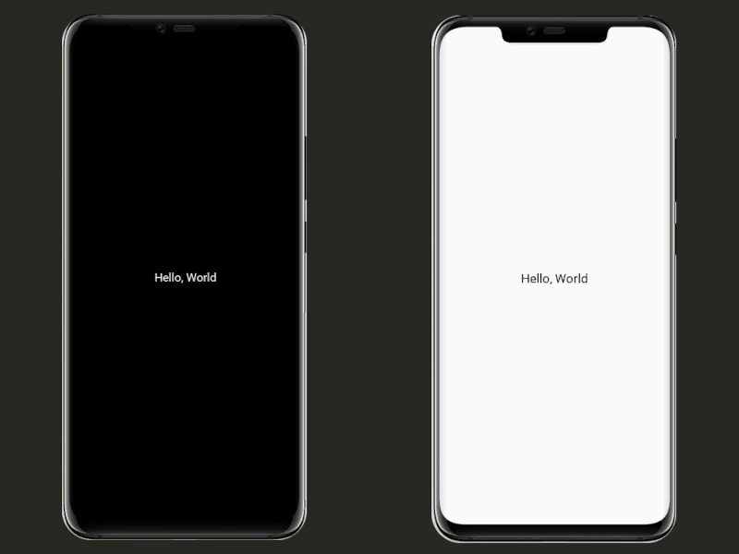
Getting started with KivyMD
from kivy.app import App
from kivy.uix.label import Label
class MainApp(App):
def build(self):
return Label(text="Hello, World")
MainApp().run()
from kivymd.app import MDApp
from kivymd.uix.label import MDLabel
class MainApp(MDApp):
def build(self):
return MDLabel(text="Hello, World", halign="center")
MainApp().run()

Slide 14


Getting started with KivyMD
Between kivy and kivymd
from kivymd.app import MDApp
from kivymd.uix.screen import MDScreen
from kivymd.uix.button import MDRectangleFlatButton
class MainApp(MDApp):
def build(self):
self.theme_cls.theme_style = "Dark"
self.theme_cls.primary_palette = "Orange"
return (MDScreen(MDRectangleFlatButton(
text="Hello, World",
pos_hint={"center_x": 0.5, "center_y": 0.5},)))
MainApp().run()
In kivymd everything goes easier

